Slide 1
An Optimization Approach to Roster Creation
Holly Wiberg
PhD Candidate, MIT Operations Research Center

Slide 2
Introduction
Overview of optimization
How to formulate roster creation as an optimization problem
Model implementation in Julia/JuMP
Model interpretation and takeaways
Data and code available at:
https://github.com/hwiberg/SSAC2020

Slide 3
What is optimization?
Optimization is a field of mathematics that involves finding the minimum or the maximum of a function under constraints.
Most problems in real life where there is uncertainty can be modeled under an optimization framework.
Why? When making decisions, we aim to achieve certain objectives while following some requirements.
Optimization allows us to formulate these problems mathematically and take a data-driven approach to decision-making.
Examples:
“How should we schedule games to:
… maximize primetime viewership?
… minimize team travel distances?
… maximize rivalries at end of season?”
“Who should I include on my team roster to maximize team performance?”
Data and code available at:
https://github.com/hwiberg/SSAC2020

Slide 4
Objective, decisions, and constraints
Let’s break down one of the previous statements:
“Who should I include on my team roster to maximize team performance?”
Decision Variables
What are the decisions that we are trying to make?
For each candidate player, decide whether or not to include them on the team.
Problem Objective
What objective do we want to maximize (or minimize), as a function of our decision variables?
Maximize team performance.
Constraints
What are the logical constraints that must be obeyed in any proposed solution?
Team must obey size restriction and have a sufficient mix of positions.
Data and code available at:
https://github.com/hwiberg/SSAC2020

Slide 5
How do we solve these problems?
We use solvers:
They are software packages;
They incorporate one or more algorithms;
They can find solutions to one or more types of problems.
I. Problem
II. Mathematical Formulation
III. Solver
IV. Solution
Data and code available at:
https://github.com/hwiberg/SSAC2020

Slide 6
Recent Speedups in MIO
Many general purpose solvers are available:
CPLEX, Gurobi, GLPK, COIN-OR
In the past 30 years, the speed of integer optimization solvers has increased by a factor of 3 trillion times!.
This doesn’t include increasing speed of computers.
A problem that can be solved in 1 second today took 71000 years to solve 30 years ago!
Data and code available at:
https://github.com/hwiberg/SSAC2020

Slide 7
Case Study: Constructing the USA Basketball Dream Team

Slide 8
Constructing an Olympic Team
USA Basketball must decide who to put on the 12-man roster for the
2020 Summer Olympics.
Source: https://www.espn.com/, https://www.olympic.org/tokyo-2020
Notes:
https://www.espn.com/nba/player/_/id/
Steph Curry, Jaylen Brown, Klay Thompson, Joe Harris, Gordon Hayward

Slide 9
We want to select a high-performing team that meets Olympic regulations and desired constraints on team composition.
How can we formalize this optimization problem as a mathematical model?
Source: https://www.usab.com/news-events/news/2016/06/2016-moly-team-announced.aspx

Slide 10
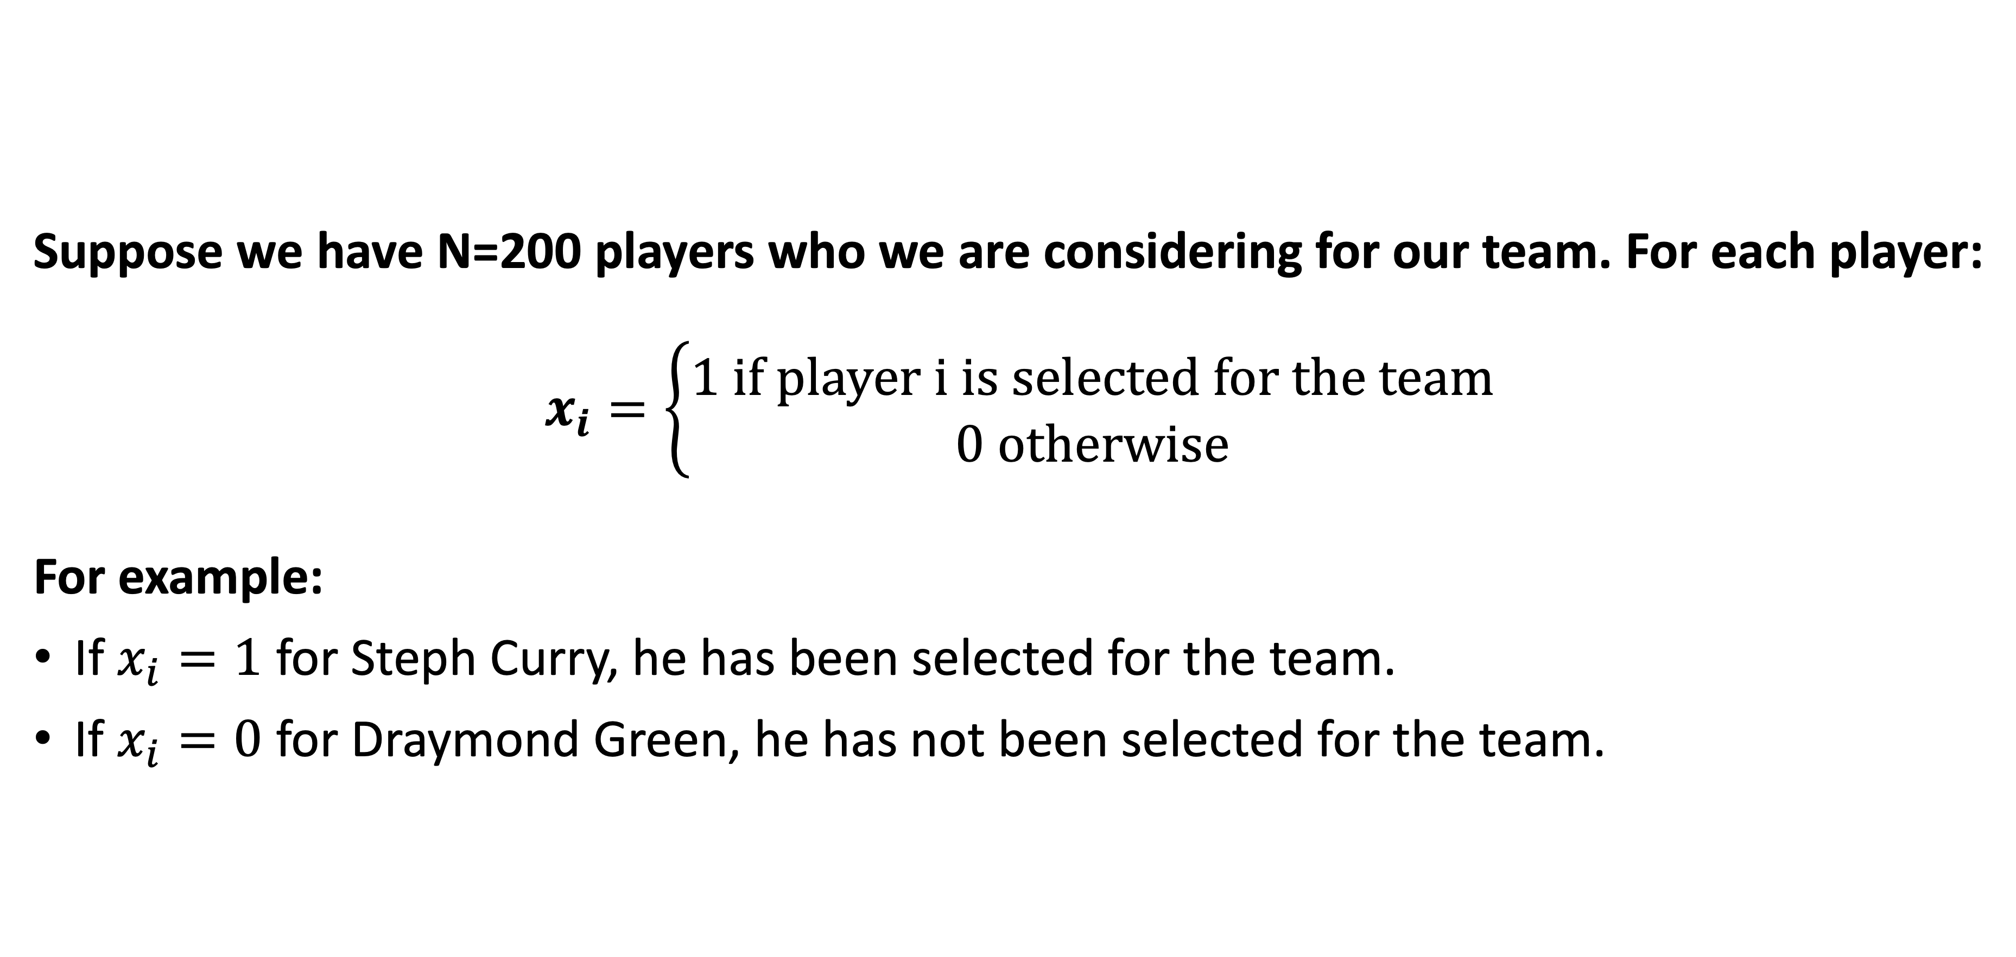
I. Defining the Decision Variables
Decision Variables
What are the decisions that we are trying to make?
For each candidate player, decide whether or not to include them on the team.
Suppose we have N=200 players who we are considering for our team. For each player:
$$x_{i}=\left\{\begin{aligned}1 \text{if} \text{player} \text{i} \text{is} \text{selected} \text{for} \text{the} \text{team} \\ 0 \text{otherwise}\end{aligned}\right.$$
For example:
If $x_{i}=1$ for Steph Curry, he has been selected for the team.
If $x_{i}=0$ for Draymond Green, he has not been selected for the team.

Slide 11
II. Formalizing the Objective
Problem Objective
What objective do we want to maximize (or minimize), as a function of our decision variables?
Maximize team performance.
Challenge: What does it mean to “maximize team performance”?
Possible Metrics: Player Efficiency Rating (PER), Box Plus/Minus (BPM), Win Shares (WS 48)
https://www.wsj.com/articles/second-spectrum-shoots-for-artificial-intelligence-in-nba-finals-1465471801

Slide 12

III. Constructing the Constraints
Constraints
What are the logical constraints that must be obeyed in any proposed solution?
Team must obey size restriction and have a sufficient mix of positions.
Team Size: We must select a team of exactly 12 players.
$$\sum_{i=1}^{50}{x_{i}}=12$$

Slide 13
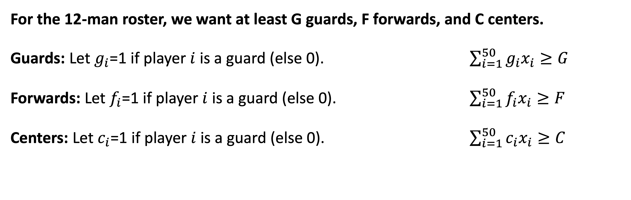
III. Constructing the Constraints
Constraints
What are the logical constraints that must be obeyed in any proposed solution?
Team must obey size restriction and have a sufficient mix of positions.
For the 12-man roster, we want at least G guards, F forwards, and C centers.
Guards: Let $g_{i}$=1 if player $i$ is a guard (else 0). $\sum_{i=1}^{50}{g_{i}x_{i}}≥G$
Forwards: Let $f_{i}$=1 if player $i$ is a guard (else 0). $\sum_{i=1}^{50}{f_{i}x_{i}}≥F$
Centers: Let $c_{i}$=1 if player $i$ is a guard (else 0). $\sum_{i=1}^{50}{c_{i}x_{i}}≥C$
… and many more!

Slide 14
Solving the Problem in Julia
Why Julia?
A high-level language:
Easy to use and learn, with a similar syntax to Python/Matlab.
It is possible to do complicated computations quickly.
A dynamic language: you can interact with the language without the need to compile your code. It is easy to use it for prototyping or presenting results, similar to Python or R.
A high-performance language: Julia is fast. Vanilla Julia code can reach performance comparable to C and Fortran (i.e., very fast).
A language for technical computing:
Julia has a lot of built in functions for scientific computing.
A growing number of packages, mostly written in Julia itself.
Powerful editors like Jupyter (used for this presentation)
More and more users in Finance, Biology, Optimization, Analytics...

Slide 15
Julia Example (in Jupyter Notebook)

Slide 16
What did we learn from our models?
[ To Complete ]

Slide 17
MIO offers a flexible decision framework
Incorporating new constraints:
NBA Team Diversity: Ensure that at least 5 distinct teams are represented on the roster.
Injury Adjustments: If a player becomes injured, we can force his decision variable to be 0 in the constraints.
Team capabilities: Beyond DBPM, we could have added constraints on average value for other metrics. We could also constrain the minimum value, such as saying that we require players to have at least a DBPM of 0 to be considered for the team.
Considering other objectives:
On a professional sports team, ownership wants to maximize performance while also controlling costs. We could add a budget constraint or include it in the objective (to be balanced with performance).
Capturing interactions between players: certain people play better when in a pair than on their own, so we may want to add constraints that the players must always appear together (or conversely, cannot both be on the team).

Slide 18
Main Takeaways
Mixed-Integer Optimization (MIO) is a powerful tool for modeling real-world decision problems and offering objective solutions.
The biggest challenge of MIO is defining and quantifying the problem.
Once a problem is formalized, Julia offers an easy-to-use interface that allows us to quickly solve large problems.
MIO has a flexible framework that allows us to easily experiment with different objectives, constraints, and model parameters.

Slide 19
Thank you!
Slides and code available at:
https://github.com/hwiberg/SSAC2020
hwiberg@mit.edu
https://hwiberg.github.io/

